Slide 1

TRANSLATION in The Church of Jesus Christ of Latter-day Saints
A BRIEF HISTORY

Slide 2
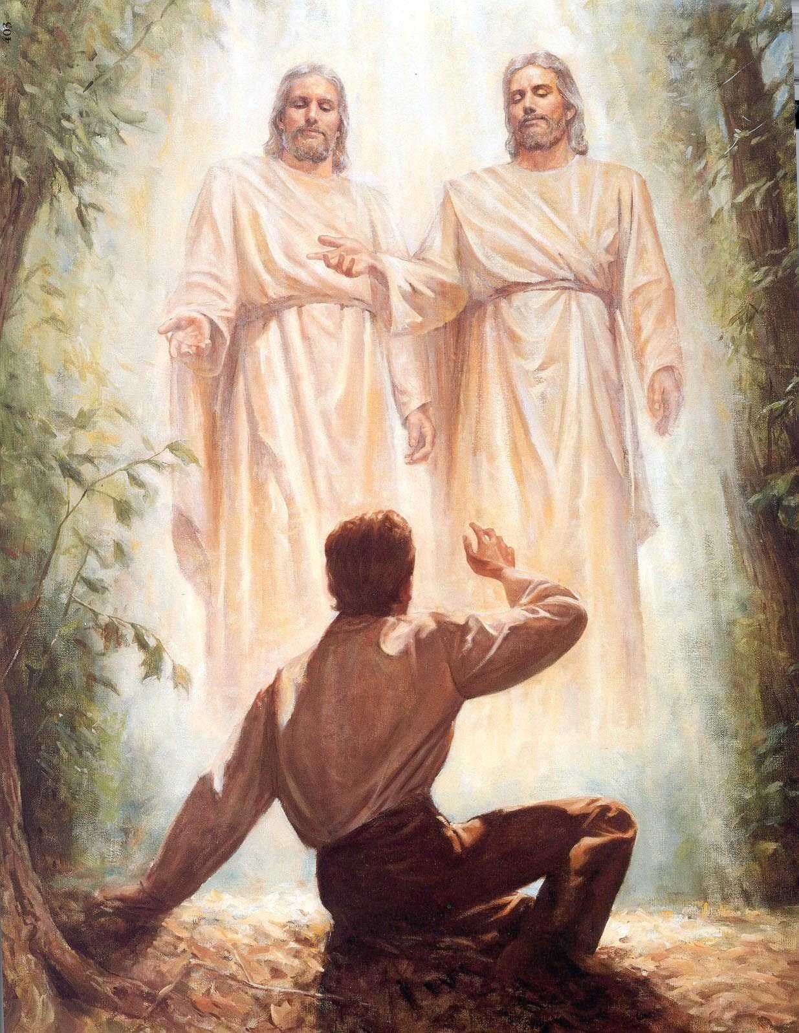
It started with a boy who was called of God.

Slide 3
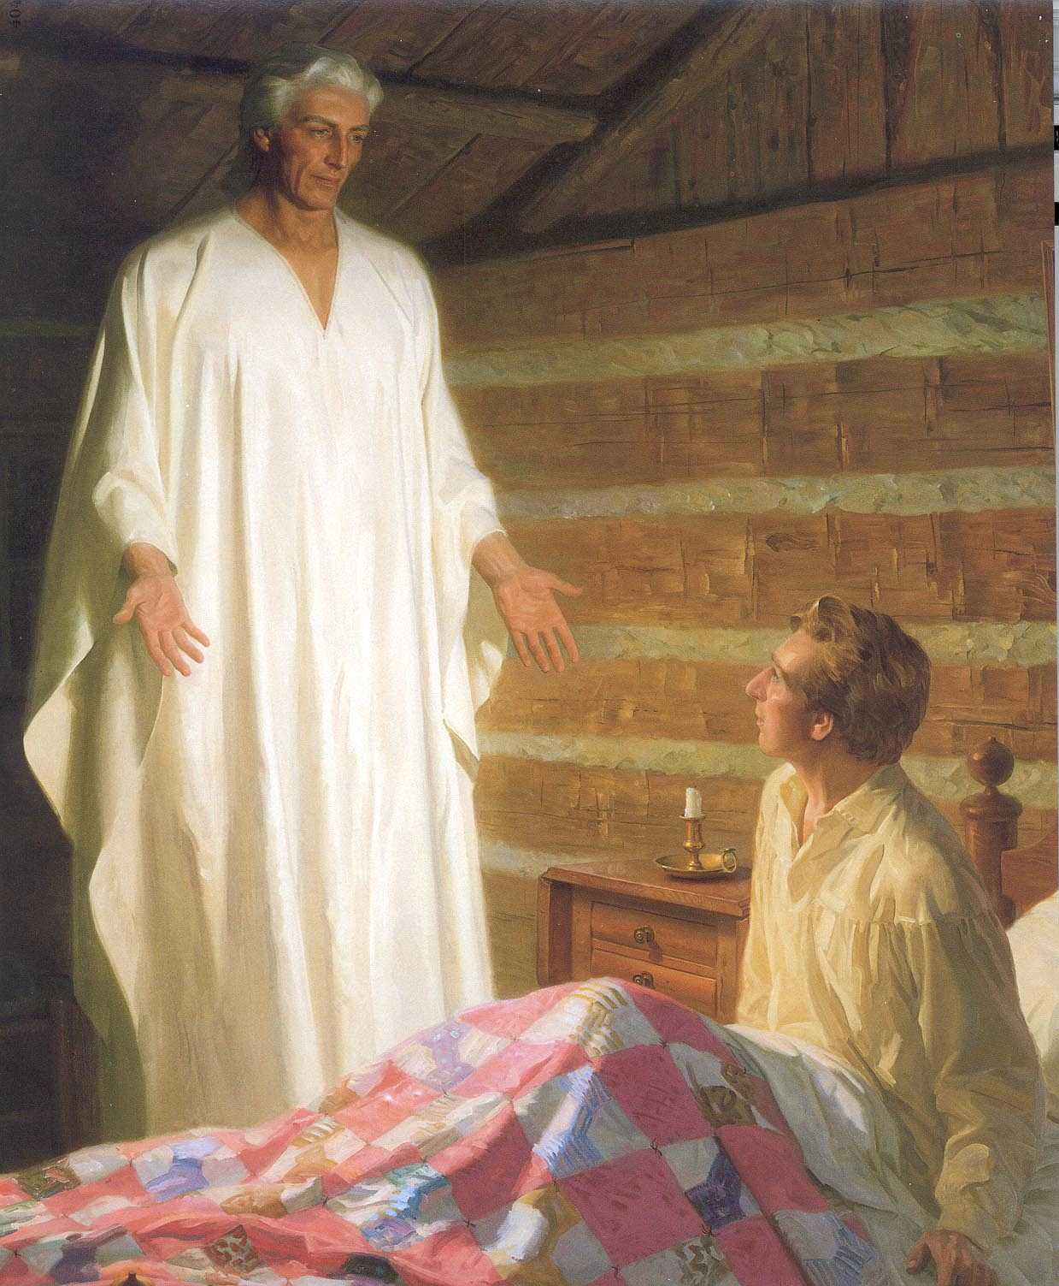
Three years later, a tutor was sent to prepare the young man for the work.

Slide 4
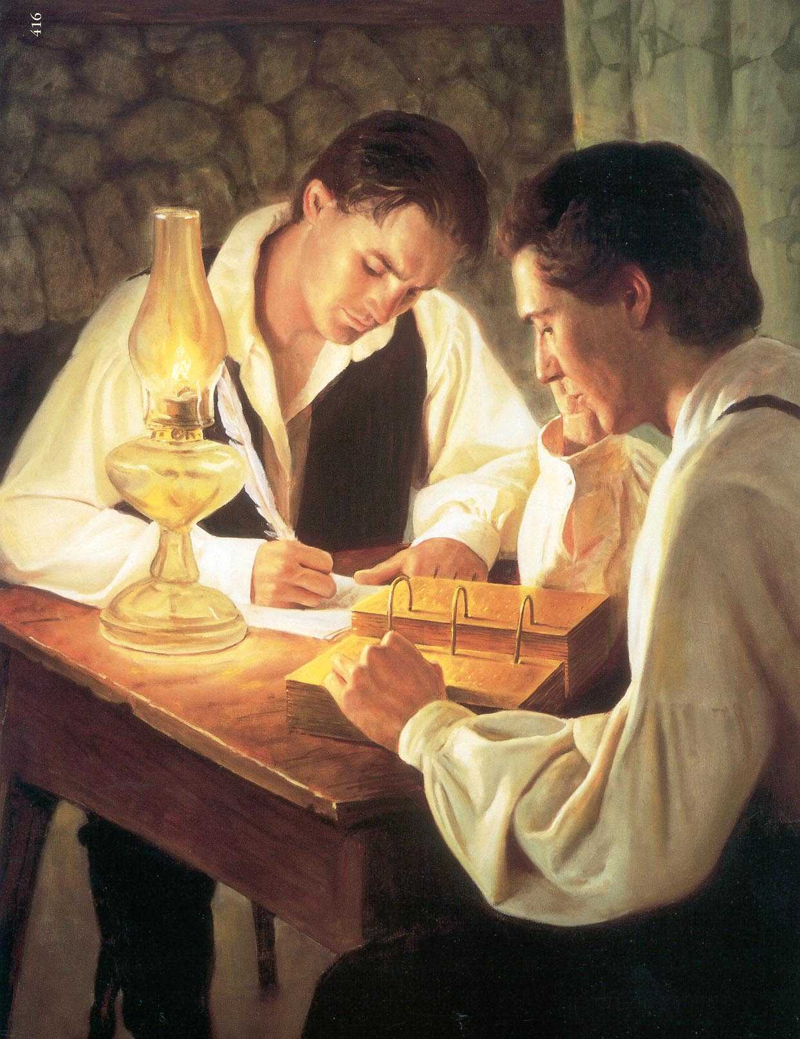
Translation began four years later.
After three years of work, the Book of Mormon was published.

Slide 5
The day the Church was organized, the Lord, speaking to this young man, said:
“Behold, there shall be a record kept among you; and in it thou shalt be called a seer, a translator, a prophet, and apostle of Jesus Christ…”

Slide 6
Two months later, Joseph Smith began a translation/revision of the Bible.
Oliver Cowdery and John Whitmer served as scribes from June until December. The first chapters of Genesis were revised and the accounts of Moses and Enoch were received.

Slide 7
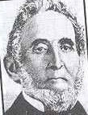
Sidney Rigdon was the scribe for the Bible project from December 1830 until it was finished in July 1833.
3,410 Bible verses were added, deleted, or corrected.

Slide 8
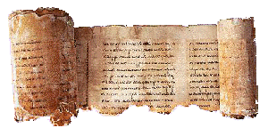
In 1835, Joseph came into possession of ancient records from Egypt which he translated. These were the writings of Abraham.

Slide 9
The Book of Mormon was not translated into another language during Joseph’s lifetime. He called missionaries to two language missions:
In 1843 four missionaries were sent to the Society Islands.
Dan Jones was called in 1844 to return to Wales as a missionary

Slide 10
By 1850 the Church had changed dramatically.
Headquarters were in the West.
Brigham Young was the prophet.
There were 52,000 members

Slide 11
Fifty missionaries were called that year and sent to ten missions. Seven were language missions. The languages were:
Danish
Hawaiian
French
German
Italian
Norwegian
Swedish
Tahitian
Welsh

Slide 12
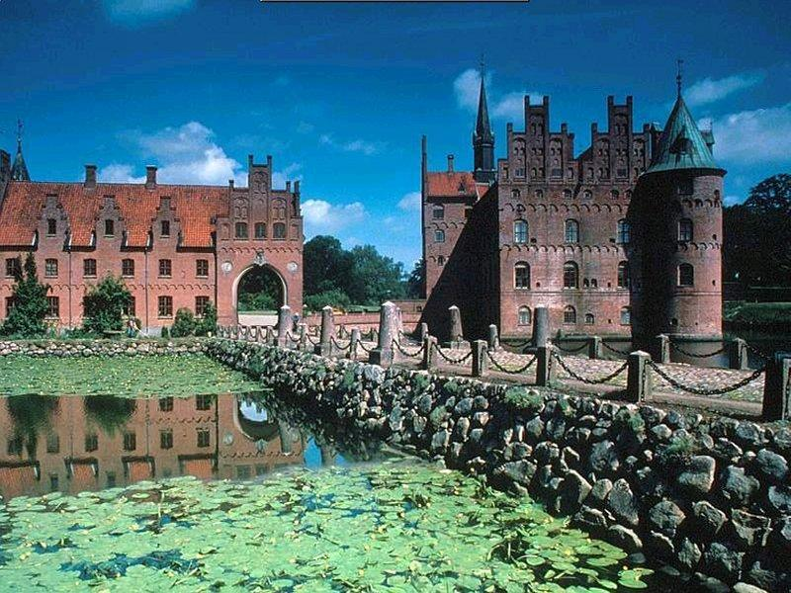
Members of the Quorum of the Twelve supervised missionary work and the translation and publication of the Book of Mormon.
The Book of Mormon was published in Danish in 1851. Elder Erastus Snow supervised the work.

Slide 13
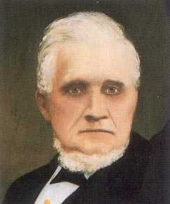
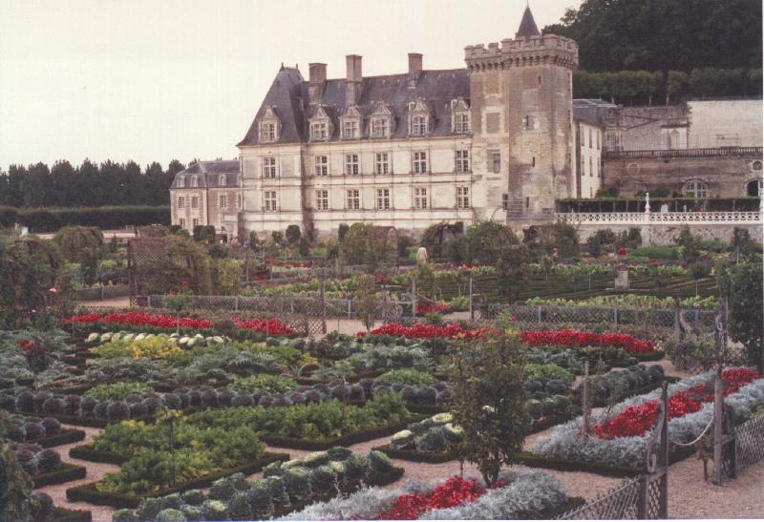
The Book of Mormon in French was published in February 1852. Elder John Taylor supervised the project.

Slide 14

The Welsh Book of Mormon was translated by John Davis and printed in installments: the first in September 1851; the last in April 1852.

Slide 15

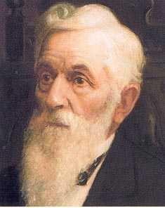
Elder Lorenzo Snow arranged for the translation of the Book of Mormon into Italian. The publication date was April 1852.

Slide 16
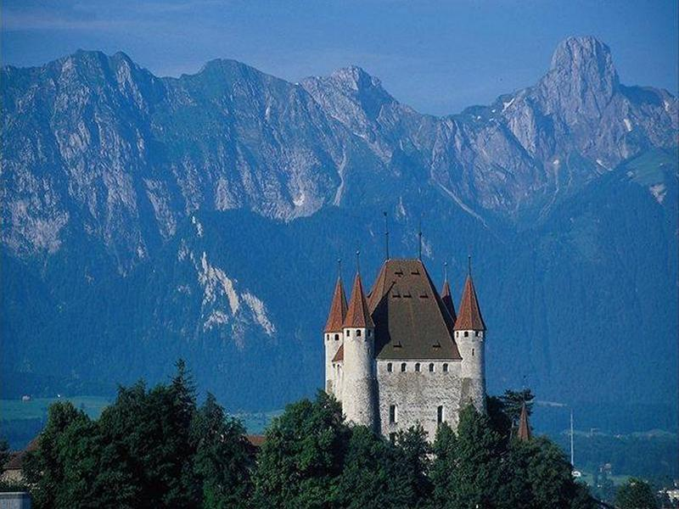
The German edition of the Book of Mormon was published in May 1852.
Elder John Taylor was the supervisor.

Slide 17
In April 1853, the First Presidency wrote in a General Epistle:
“Translate the Book of Mormon into every language and dialect under heaven, and print the same, as God shall give you opportunity. And from this hour the gift of tongues, and by it translations, from language to language, shall be more manifest unto the elders of Israel, until no nation, kindred, tribe, or family shall be destitute of the offering of the word of God on earth.”

Slide 18

In 1855, the Book of Mormon was published in Hawaiian.

Slide 19
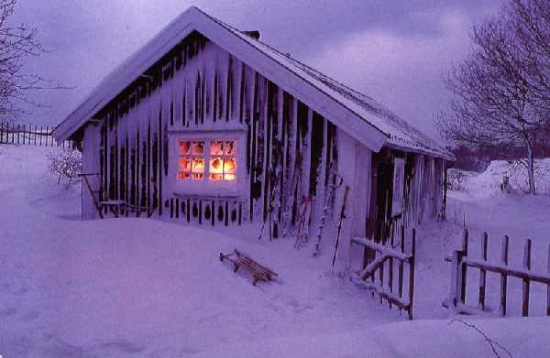
Twenty years passed--then in 1878, the Swedish Book of Mormon was translated and issued to 600 subscribers in 64-page installments.

Slide 20
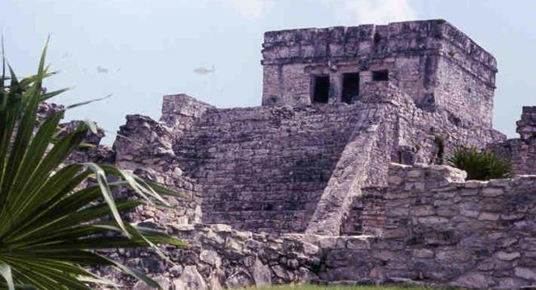
A 96-page Spanish selections from the Book of Mormon was published in 1875. In 1886, the full Spanish Book of Mormon was printed. It was translated by Meliton Trejo, a convert from the Philippines, but a native of Spain.

Slide 21
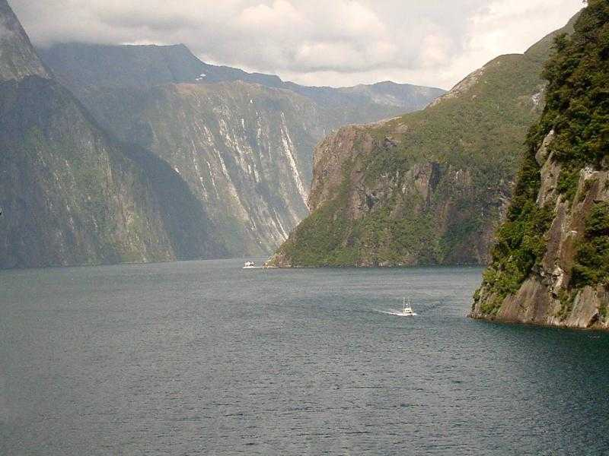
The last edition of the Book of Mormon in the 1800’s was the New Zealand Maori edition in 1889.

Slide 22
Other items were published before 1900. Missionary tracts were among the first items. Hymnals were published in eight languages:
Welsh 1846
Danish 1851
French 1857
Swedish 1860
German 1861
Dutch 1884
Hawaiian 1885
Turkish 1899

Slide 23
Church newspapers were the forerunners of the international magazine. The earliest were:
Welsh 1848
French 1852
German 1861
Danish 1874
Swedish 1877

Slide 24
The Doctrine and Covenants appeared in five languages before 1900:
Welsh 1851
Danish 1852
German 1876
Swedish 1888
Hawaiian 1893

Slide 25
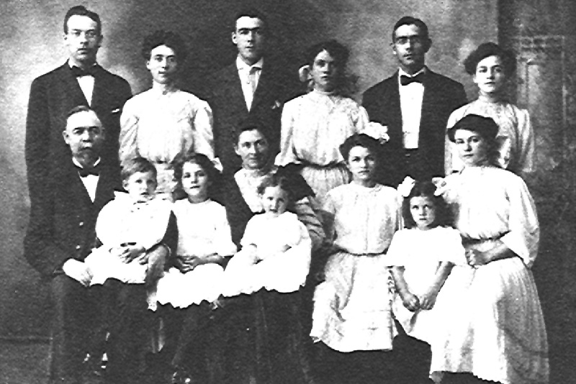
At the turn of the century the Church was still relatively small. There were 272,000 members.

Slide 26
In 1899 there were 20 missions and 324 missionaries were called. Only 10 missions were foreign language speaking. The major mission languages were:
Danish
Dutch
Hawaiian
French
German
Norwegian
Spanish
Swedish
Tahitian
Turkish

Slide 27
1900 to 1970 Scripture translation fell into two groups: 1900-1909 Samoan 1903 Turkish 1906 Tahitian 1904 Japanese 1909
1933-1967
Czech 1933 Norwegian 1950
Armenian 1937 Finnish 1959
Portuguese 1939 Chinese 1959
Tongan 1946 Korean 1967

Slide 28
In 1947, a translation department was organized in Salt Lake City with 10 employees.
Danish 1 FTE Norwegian 1 FTE
Dutch 1 FTE Samoan 1 FTE
French 1 FTE Swedish 1 FTE German 1 FTE Spanish 3 FTEs
They served under the Church Radio, Publicity, and Mission Literature Committee. The secretary to the committee was Gordon B. Hinckley.
Some translation was still done in the field.

Slide 29
In 1965 the translation operation was placed under the Presiding Bishopric and the language offices were moved to the field.
Offices were first established in Europe.
Danish 2 FTE’s No volunteers
Dutch 3 FTE’s 15 volunteers
Finnish 1 FTE 12 volunteers
French 4 FTE’s No volunteers
German 2 FTE’s 5 volunteers
Italian 2 FTE’s No volunteers
Norwegian 3 FTE’s 10 volunteers
Swedish 1 FTE 45 volunteers

Slide 30
Later, offices were added in Japan, Korea, Taiwan, Samoa, Tonga, Tahiti, Brazil, and Mexico City. Curriculum items were translated into the 16 “established languages.”
Some work was also done in “emerging languages.” Some of these were:
Afrikaans
Arabic
Czech
Indonesian
Navajo
Rarotongan
Thai
Vietnamese

Slide 31
Translators notes help translators understand the English text.
At first, research was conducted in each language office. In the 1960s, uniform translators notes were made in Salt Lake. This was more economical and helped the translations to be more uniform.
Today this is called Translation Support.

Slide 32
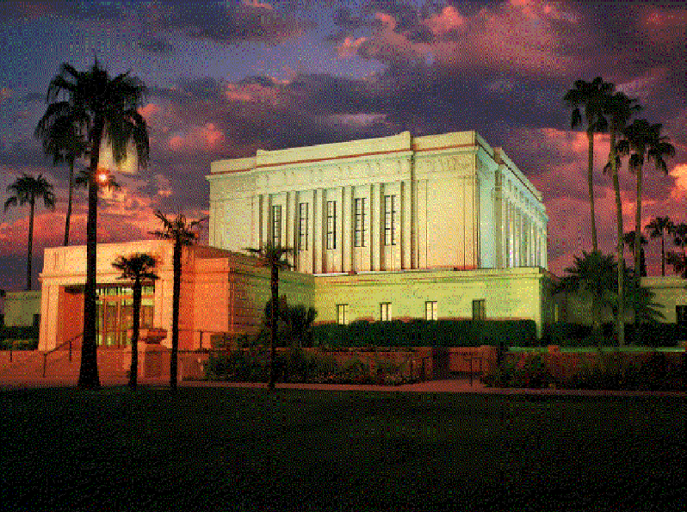
The first temple ordinance translation was Spanish in 1940. It was used in the Arizona Temple for temple excursions from Mexico.

Slide 33
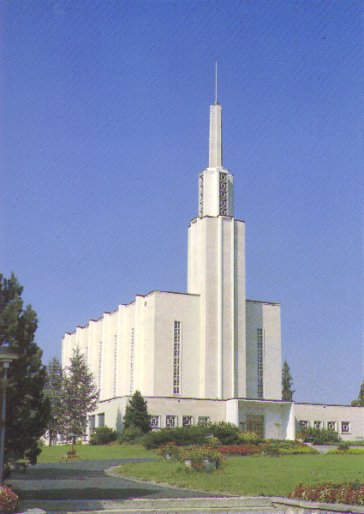
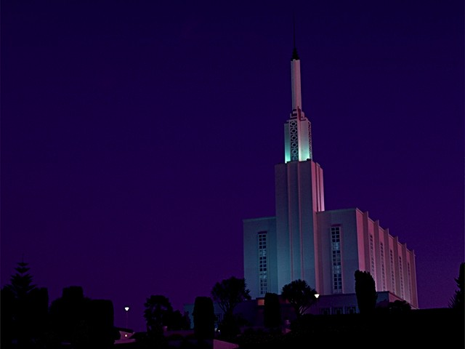
The completion of the Swiss temple in 1955 and the New Zealand temple in 1958 made other translations necessary.
German and Norwegian were completed in 1951.

Slide 34
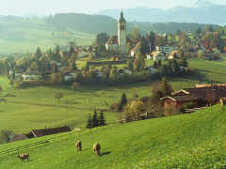
The Dutch temple ordinance was done in 1954.
Three European languages were completed in 1955:
Swedish
Finnish
French

Slide 35

In 1955 four South Pacific languages were completed for the New Zealand temple:
Maori
Samoan
Tahitian
Tongan

Slide 36

Four Asian languages followed:
Japanese 1965
Korean 1970
Cantonese 1971
Mandarin 1971

Slide 37
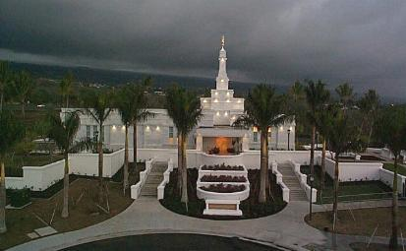
In the 1980s and 1990s the translation of temple ordinances accelerated dramatically.
The temple ordinances have been translated in 74 languages.

Slide 38
Official interpretation of general conference started in 1961, the year the first non-English stakes were organized. In that time, overseas stake presidents and bishops were brought to general conference.
Dutch, German, Samoan and Spanish interpreters were seated with the visiting Church leaders in a small room under the Tabernacle Choir seats.

Slide 39
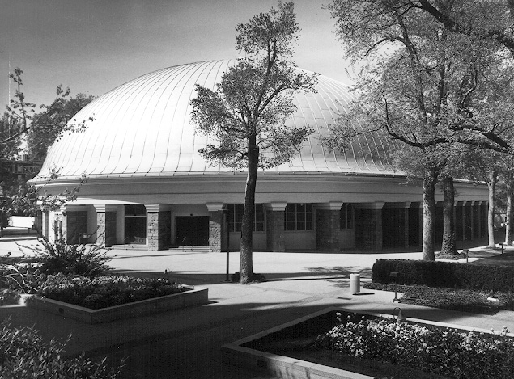
When earphones were installed in the Tabernacle, the interpretation teams worked on banquet tables in a tent in the unfinished basement of the Assembly Hall.
When the basement was excavated under the Tabernacle, sixteen small booths were built for interpreters.

Slide 40
Portuguese was interpreted in 1966 and Tongan in 1968. The next languages were:
Japanese
Tahitian
Korean
Danish
Cantonese
Mandarin
French
Norwegian
Swedish
Italian
Navajo
By 1981, there were 17 languages; however,
interpretation was generally for those attending
conference in the Tabernacle.

Slide 41
Later, the number of interpretation booths was expanded to 40 and interpretation was delivered by phone, television, satellite, and videos.
The Conference Center has 59 interpretation booths and combined with booths in the Tabernacle there is capacity for 99 languages.
In October 2000, 145,000 people attended general conference in the Conference Center.
3,000,000 watched on KSL-TV and KBYU-TV.
13,000,000 in the US and Canada have cable access to conference proceedings.

Slide 42
Conference is broadcast live by satellite to North America, Latin America, Europe, and Africa.
In the US and Canada there are 3,781 downlinks. In Latin America there are 462 downlinks.
In Europe there are 285 downlinks.
In Africa there are 9 downlinks.
110,000 people in 99 countries listened on the Internet in 35 languages.
Videotapes of conference were sent to 20 international areas.

Slide 43
The October 2000 General Conference
was interpreted in 49 languages.
Twice a year, over 500 interpreters and volunteers are involved in
general conference interpretation.
Interpretation services have expanded to Mission Presidents’ Seminars, Temple Presidents’ Seminars and dozens of other training and broadcast functions.

Slide 44
In 1975 the first computer arrived at the Translation Department.
It was the Redactron. It looked like a cross between a garbage compactor and R2D2, but was not as smart as the garbage compactor, nor as polite as R2D2. It was attached to an electric typewriter and worked by recording keystrokes on a cassette tape.

Slide 45
Next came the Mergenthaller. It was the size and shape of a washing machine and ran like a computer game. It produced a punched tape which was fed to a typesetting machine.
About 1979 the first real computer arrived. It was a DEC, as large as a refrigerator, with an astounding 20 megabytes of memory!

Slide 46
Next came the Wang, the Mac, and the PC. Today everyone has a PC in their room. Your personal PC has more computer power than the entire NASA operation possessed when they put a man on the moon!

Slide 47
The Church Internet sites have millions of hits daily.
The Church Internet portal contains English scriptures, magazines, curriculum, and conference talks in 35 languages.
All of these features are envisioned in many languages, an enormous translation undertaking.

Slide 48
Internet Users
Millions

Slide 49
The Church family history computer program, the Personal Ancestral File, has been translated into French, German, Spanish and Portuguese.
It can be downloaded from the Internet.
19% of all downloads are non-English.
The French Genealogical Association rated the French PAF 4.0 as the best of any program of its kind.

Slide 50
Two significant events enlarged the role of translation in the Church and expanded the work to more nations.
In 1978 the revelation on the priesthood for all worthy male members was received.
In 1991 the 15 republics of the former Soviet Union became independent.

Slide 51
Two other factors accelerated the rate at which translations must be delivered.
The extensive use of satellite technology in delivery of conference and other programs to a large part of the world.
The dramatic growth of Internet use and the creation of the Church Internet portal.

Slide 52
The 1980s and 1990s have been the era of greatest growth and activity for translation work in the Church.
In the 1980s, 65 language editions of the Book of Mormon, Selections from the Book of Mormon, or the Doctrine and Covenants/Pearl of Great Price were translated.
In the 1990s, 73 language editions of the scriptures were translated or recorded.

Slide 53
Nonscripture translation has been done in 182 languages.
23 languages have full-time offices and personnel.
Seven managers direct the work with 6 of them living overseas.
Another 8 supervisors oversee
work in 75 languages where contract, on-call, or volunteer workers do
the translation.
170,000 pages of Nonscripture translation were produced In 1999.

Slide 54
How far have we come? How far do we have to go?
There are over 11 million members of the Church. Rodney Stark, a non-member religious scholar, calls Mormonism the “Next Great Religion,” and predicts 265 million LDS members by the year 2080.

Slide 55
In February 1996, a signpost was reached. There were more church members living outside of the United States than inside.
Four years later, in September 2000, the second signpost--the Church had more non-English speakers than English speakers.
Based on current projections, by the year
2020 Spanish speakers will be the largest language group in the Church.

Slide 56
The Church has a presence in 152 nations. However, it is projected that by the year 2100 there could be 500 nations on the earth.
The colonial powers are gone.
The great national powers of the world are losing their economic, military and moral grip.
Nations are dividing and re-dividing.
We are witnessing the
retribalization of the world.

Slide 57
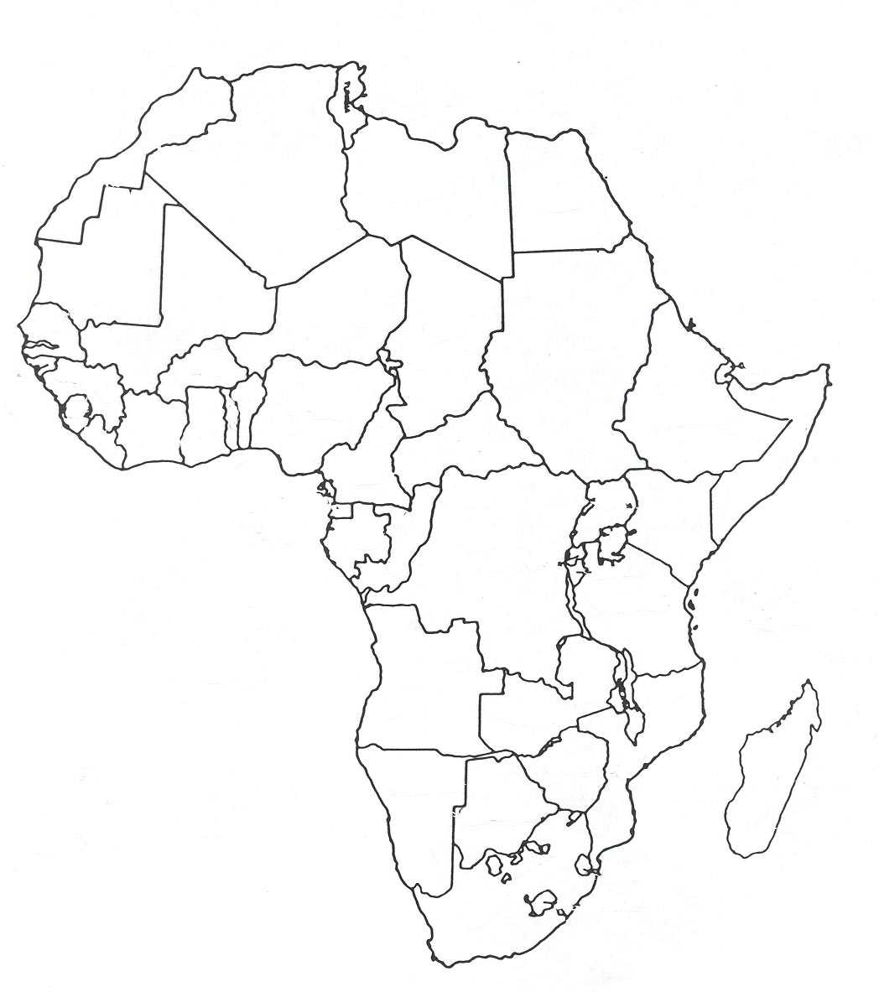
This is the political map of Africa with tidy divisions made by English administrators, French negotiators and German surveyors.

Slide 58
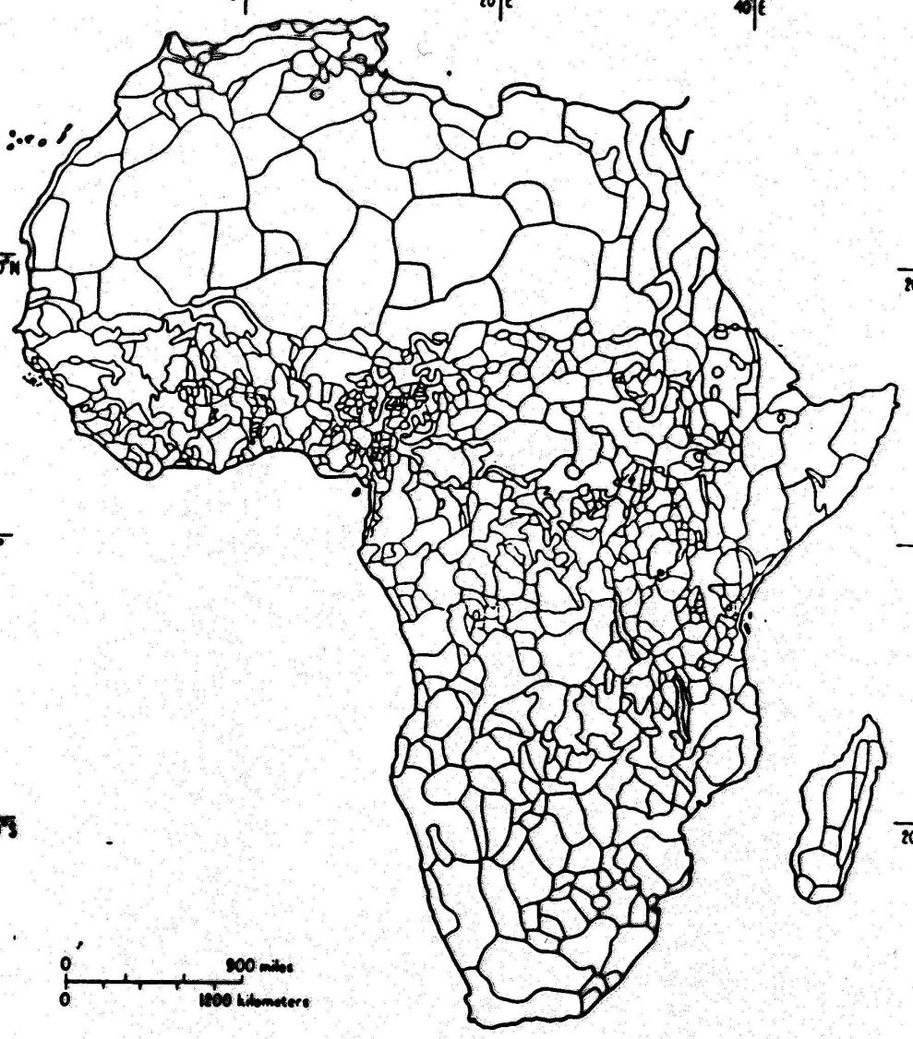
This is a map of Africa showing the true ethnic divisions. Each represents a separate tribe, culture, and language.

Slide 59
As new nations, countries, kingdoms, and dominions emerge, they embrace their particular culture and legislate their unique language.
Some languages of minor significance today will be national languages in the future.

Slide 60
The history of translation in the Church of Jesus Christ of Latter-day Saints has been marvelous.
It has gone from one young man
to hundreds of employees
and thousands of volunteers.
Offices are established worldwide.
The work will expand and accelerate at an exponential rate.

Slide 61
In 170 years we have done translation work in 182 languages.
There are, however, in the world today, over 3,000 languages in everyday use.

Slide 62
Because many of the languages we have translated are major languages, a majority of the world’s inhabitants have access to the gospel message.
However, millions and millions still await the fulfillment of the promise “that every man shall hear the fulness of the gospel in his own tongue, and in his own language.”

Slide 63
Providing the message of the restored gospel to all of God’s children on the earth will require an expansion of our vision and an acceleration of our work in ways that we can hardly even imagine at this time.

Slide 64
We are only the forerunners and pioneers, preparing the way
for the enormous effort which will be required
to complete the work and usher in the Millennial Reign.

